Slide 1

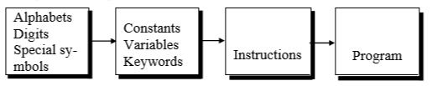
Steps in Learning a Natural Language
Learning a Programming Language

Slide 2
Layout of a C program
pre-processor directives – Preceded by a ‘#’
global declarations – Optional and not a good programming practice
int main() - standard start for all C programs
{
local variables to function main ; - all variables used in the function must be declared in the beginning
statements associated with function main ;
}
void f1()
{
local variables to function 1 ;
statements associated with function 1 ;
}

Slide 3
Components of a C program
A C program consists of the following parts:
Comments
Variables
Preprocessor Commands
Functions
Statements & Expressions

Slide 4
Comments in C
Two types of comments
Single line and multi line comment
Single Line Comment is double forward slash ‘//’ and can be Placed Anywhere

Slide 5
Multiline Comments in C
Multi line comment can be placed anywhere
Multi line comment starts with /*
Multi line comment ends with */
Any symbols written between '/*’ and '*/‘ are ignored by Compiler

Slide 6
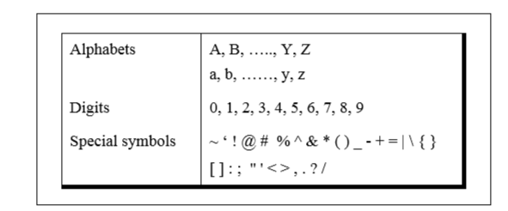
Character set of C

Slide 7
Constants, Variables and Keywords
alphabets, numbers and special symbols when properly combined form constants, variables and keywords
Constant - entity that doesn’t change
Variable - entity that may change
Keyword – reserved in programming language (Equivalent to words in natural language with predefined meaning)

Slide 8
Types of C Variables
Variable names - Names given to locations in memory
Locations can contain integer or character constants
In any language, types of variables supported depend on the types of constants that it can handle
Because a particular type of variable can hold only same type of constant
Integer variable - integer constant and a character variable - a character constant

Slide 9
Rules for Constructing Variable Names
Rules for constructing variable names of all types are same
Combination of 1 to 31 alphabets, digits or underscores
Some compilers allow up to 247 characters but safer to 31 characters
First character must be an alphabet or underscore
No commas or blanks are allowed
No special symbol other than an underscore
Eg: si_int m_hra pop_e_89

Slide 10
Data types in C
Basic Arithmetic types - further classified into: (a) integer types and (b) floating-point types
Enumerated types - arithmetic types that are used to define variables that can be assigned only certain discrete integer values throughout the program
Type void - indicates that no value is available
Derived types - They include (a) Pointer types, (b) Array types, (c) Structure types, (d) Union types and (e) Function types

Slide 11
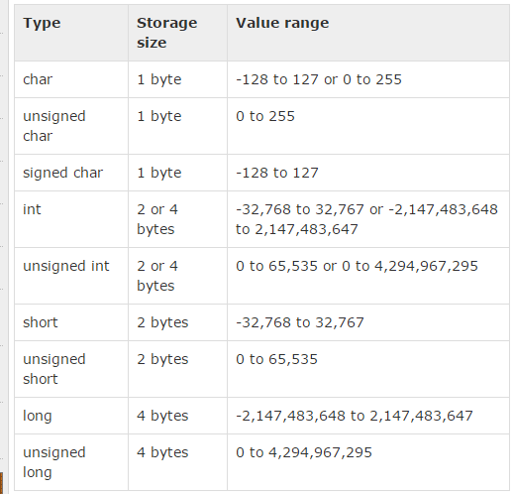
Integer Types

Slide 12
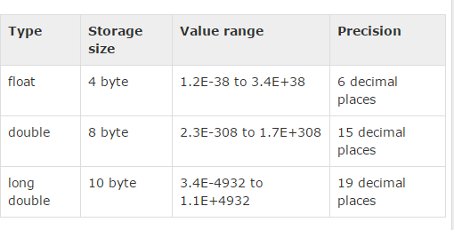
Floating Point Types

Slide 13
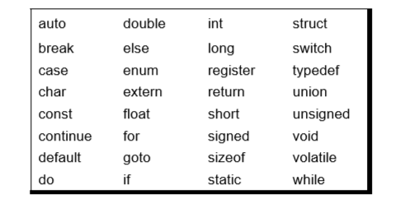
Keywords
32 keywords available in C
Compiler vendors (like Microsoft, Borland, etc.) provide their own keywords

Slide 14
Discuss Valid and Invalid variable names
BASICSALARY
_basic
basic-hra
#MEAN
group.
422
population in 2006
FLOAT
hELLO

Slide 15
I/O in C
Basic operation in any language
Input is got through a function scanf which is equivalent to input or raw_input in Python
Syntax of scanf
int scanf(const char *format, ...)
Basically two or more arguments
First format string, followed by address of variables that are going to hold values entered by user

Slide 16
I/O in C
int printf(const char *format, ...)
contains one or more arguments
first argument is the format string

Slide 17
printf and scanf format codes
code | type | format
d | int | decimal (base ten) number
o | int | octal number (no leading '0' supplied in printf)
x or X | int | hexadecimal number (no leading '0x' supplied in printf; accepted if present in scanf) (for printf, 'X' makes it use upper case for the digits ABCDEF)
ld | long | decimal number ('l' can also be applied to any of the above to change the type from 'int' to 'long')

Slide 18
printf and scanf format codes
code | type | format
u | Unsigned int | decimal number
lu | unsigned long | decimal number
c | char [footnote] | single character
s | char pointer | string
f | float [footnote] | number with six digits of precision
lf | double [footnote] | number with six digits of precision

Slide 19
Format specifier | Description | Supported data types
%c | Character | char unsigned char
%d | Signed Integer | short unsigned short int long
%e or %E | Scientific notation of float values | float double
%f | Floating point | float
%g or %G | Similar as %e or %E | float double
%hi | Signed Integer(Short) | short
%hu | Unsigned Integer(Short) | unsigned short
%i | Signed Integer | short unsigned short int long

Slide 20
%l or %ld or %li | Signed Integer | long
%lf | Floating point | double
%Lf | Floating point | long double
%lu | Unsigned integer | unsigned int unsigned long
%lli, %lld | Signed Integer | long long
%llu | Unsigned Integer | unsigned long long
%o | Octal representation of Integer. | short unsigned short int unsigned int long
%p | Address of pointer to void void * | void *
%s | String | char *
%u | Unsigned Integer | unsigned int unsigned long
%x or %X | Hexadecimal representation of Unsigned Integer | short unsigned short int unsigned int long
%n | Prints nothing
%% | Prints % character

Slide 21
Address of a variable
Address of a variable can be obtained by putting a ‘&’ before the variable name

Slide 22
Arithmetic instructions in C
To perform arithmetic operations between constants and variables
Operands shall be either constant or variables
Variables can be of any type of integer or floating point value or character except for modulus operator
Modulus operator cannot be applied for floating point values but can be applied for integer and character types

Slide 23
Example 1
#include<stdio.h> void main() { int a = 27; int b = 25; int c = a -b; printf("%d",c); }

Slide 24
Output 1
2

Slide 25
Example 2
#include<stdio.h> void main() { char a = 273; char b = 25; int c = a%b; printf("%d",c); }

Slide 26
Output 2
warning: overflow in implicit constant conversion [-Woverflow]
17
Character – range is 0 to 255
256 is 0
257 is 1 and so on

Slide 27
Example 3
#include<stdio.h> void main() { char a = 27; char b = 25; char c = a -b; printf("%c",c); }

Slide 28
Output 3
A special character

Slide 29
Arithmetic Operators in C
Operator | Description
+ | Adds two operands
− | Subtracts second operand from the first.
∗ | Multiplies both operands
∕ | Divides numerator by denominator
% | Modulus Operator and remainder of after an integer division.
++ | Increment operator increases the integer value by one
-- | Decrement operator decreases the integer value by one

Slide 30
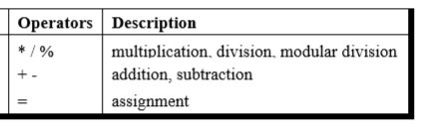
Precedence of Operators in C
++, -- Post increment Operators
++, -- Pre increment Operators
Parenthesis can be used to override default precedence

Slide 31
Example 4
#include<stdio.h> main() { int a, b,c; a = 4; b = 2; c = -a+--b; printf ( "c = %d", c) ; }

Slide 32
Output 4
c = -3

Slide 33
Example 5
#include<stdio.h> main() { int a, b,c; a = 4; b = 2; c = -a+ b--; printf ( "c = %d", c) ;
printf ( "b = %d", b) ; }

Slide 34
Output 5
c = -2
b = 1

Slide 35
Example 6
#include<stdio.h> main() { int a, b,c; a = 4; c = ++a + a++; printf ( "c = %d", c) ; printf ( "a = %d", a) ; }

Slide 36
Output 6
c = 10 a = 6

Slide 37
Example 7
#include<stdio.h> main() { int a, b,c; a = 4; c = ++a + ++a; printf ( "c = %d", c) ; printf ( "a = %d", a) ; }

Slide 38
Output 7
c = 12 a = 6

Slide 39
Example 8
#include<stdio.h> main() { int a, b,c; a = 4; c = a++ + ++a; printf ( "c = %d", c) ; printf ( "a = %d", a) ; }

Slide 40
Output 8
c = 10 a = 6

Slide 41
Associativity of Operators in C
When precedence of two operators are same then associativity of operator is considered for evaluation

Slide 42
Operator | Meaning of operator | Associativity
() [] -> . | Functional call Array element reference Indirect member selection Direct member selection | Left to right
! ~ + - ++ -- & * sizeof (type) | Logical negation Bitwise(1 's) complement Unary plus Unary minus Increment Decrement Dereference (Address) Pointer reference Returns the size of an object Typecast (conversion) | Right to left
* / % | Multiply Divide Remainder | Left to right
+ - | Binary plus(Addition) Binary minus(subtraction) | Left to right
<< >> | Left shift Right shift | Left to right

Slide 43
< <= > >= | Less than Less than or equal Greater than Greater than or equal | Left to right
== != | Equal to Not equal to | Left to right
& | Bitwise AND | Left to right
^ | Bitwise exclusive OR | Left to right
| | Bitwise OR | Left to right
&& | Logical AND | Left to right
|| | Logical OR | Left to right
?: | Conditional Operator | Right to left
= *= /= %= += -= &= ^= |= <<= >>= | Simple assignment Assign product Assign quotient Assign remainder Assign sum Assign difference Assign bitwise AND Assign bitwise XOR Assign bitwise OR Assign left shift Assign right shift | Right to left
, | Separator of expressions | Left to right

Slide 44
Compile and Run
Compile and run the program named as isogram.c
gcc isogram.c – to compile
./a.out – to run

Slide 45
Automatic Type Conversion in C
Convert a variable from one data type to another data type
When the type conversion is performed automatically by the compiler without programmers intervention, such type of conversion is known as implicit type conversion or type promotion.
The compiler converts all operands into the data type of the largest operand.

Slide 46
Rules for Implicit Type Conversion in C
Sequence of rules that are applied while evaluating expressions are given below:
All short and char are automatically converted to int, then,
If either of the operand is of type long double, then others will be converted to long double and result will be long double.
Else, if either of the operand is double, then others are converted to double.
Else, if either of the operand is float, then others are converted to float.

Slide 47
Rules for Type Conversion in C
Else, if either of the operand is unsigned long int, then others will be converted to unsigned long int.
Else, if one of the operand is long int, and the other is unsigned int, then
if a long int can represent all values of an unsigned int, the unsigned int is converted to long int.
otherwise, both operands are converted to unsigned long int.
Else, if either operand is long int then other will be converted to long int.
Else, if either operand is unsigned int then others will be converted to unsigned int.

Slide 48
Example 9
#include<stdio.h> void main() { char a = 65; char b = 100; int c = a%b; printf("%c",c); }

Slide 49
Output 9
A

Slide 50
Example 10
#include<stdio.h> void main() { int a = 165; int b = 100; int c = a/b; printf("%d",c); }

Slide 51
Output 10
1

Slide 52
Example 11
#include<stdio.h> void main() { int a = 165; int b = 100; float c = a/b; printf("%f",c); }

Slide 53
Output 11
1.000000

Slide 54
Example 12
#include<stdio.h> void main() { int a = 165; int b = 100; float c = a/b; printf("%f",c); }

Slide 55
Output 12
1.000000

Slide 56
Example 13
#include<stdio.h> void main() { int a = 165; float b = 100; float c = a/b; printf("%f",c); }

Slide 57
Output 13
1.650000

Slide 58
Explicit Type Conversion
Type conversion performed by the programmer is known as explicit type conversion
Explicit type conversion is also known as type casting.
Type casting in c is done in the following form:
(data_type)expression;
where, data_type is any valid c data type, and expression may be constant, variable or an expression
For example, x=(int)a+b*d;

Slide 59
Explicit Type Conversion
The following rules have to be followed while converting the expression from one type to another to avoid the loss of information:
All integer types to be converted to float.
All float types to be converted to double.
All character types to be converted to integer.

Slide 60
Example 14
#include<stdio.h> void main() { int a = 165; int b = 100; float c = (float)(a/b); printf("%f",c); }

Slide 61
Output 14
1.000000

Slide 62
Example 15
#include<stdio.h> void main() { int a = 165; int b = 100; float c = (float) a/b; printf("%f",c); }

Slide 63
Output 15
1.650000

Slide 64
Assignment
Students have to check all operators for all types of operands, also work on to understand precedence of operators

Slide 65
Scope and Lifetime of a Variable in C Language
Scope of a variable - Area of our program where we can actually access the variable.
Life Time of a variable - Time for which the particular variable outlives in memory during execution of program.

Slide 66
Global vs Local Scope
Global scope :
When variable is defined outside all functions.
It is then available to all the functions of the program and all the blocks program contains.
Local scope :
When variable is defined inside a function or a block, then it is locally accessible within the block and hence it is a local variable.

Slide 67
Global vs Local Scope
int global = 100; // global variable declared
void main()
{
int local = 10; // local variable declared
printf("Global variable is %d",global);
printf("Local variable is %d",local);
func1();
}
void func1()
{
printf("Global inside func1 is %d",global);
}

Slide 68
Storage Classes in C
Four Storage Classes, classified based on life and scope of access:
Storage Class | Life | Scope
Auto | Created when a function is called and destroyed automatically when function exits Default – int n; | Can be accessed only within the function where it is declared
Register | Similar to Auto but stored in register, a faster memory. Number of register is limited. Therefore automatically converted to auto if necessary register int number; | Similar to Auto

Slide 69
Storage Classes in C
Storage Class | Life | Scope
Static | Created when a function is called Mandatory for programmer to initialize Lives till the program executes static int n =10; | Accessible only inside the function where it is defined
Extern | Created when the program execution starts extern int n; | Global variables that can be shared across files

Slide 70
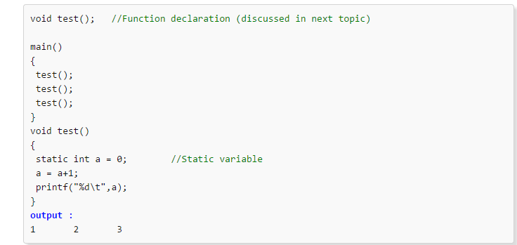
Static in C

Slide 71
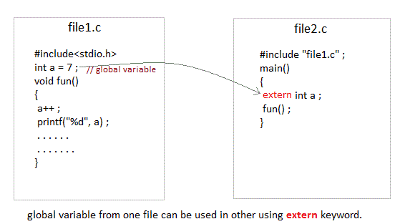
Extern in C

Slide 72
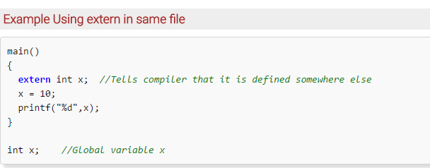
Extern in C

Slide 73
Declaration and Definition of Variables in C
Declaration – Information to compiler about the variable
Definition – Memory is allocated for the variable according to type
For all storage classes declaration and definition are same except for extern
When a keyword extern precedes, its only a declaration and the compiler waits for definition without raising error

